Slide 2

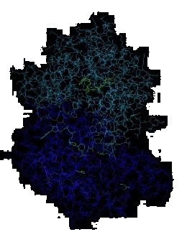


Molecular Biology through Discovery Tuesday, 17 January 2017

Slide 3
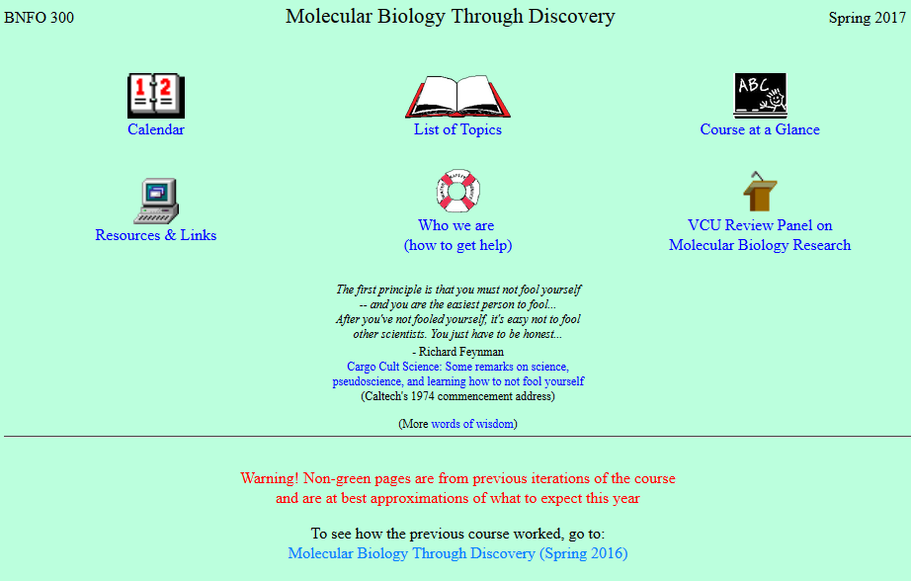

Slide 4
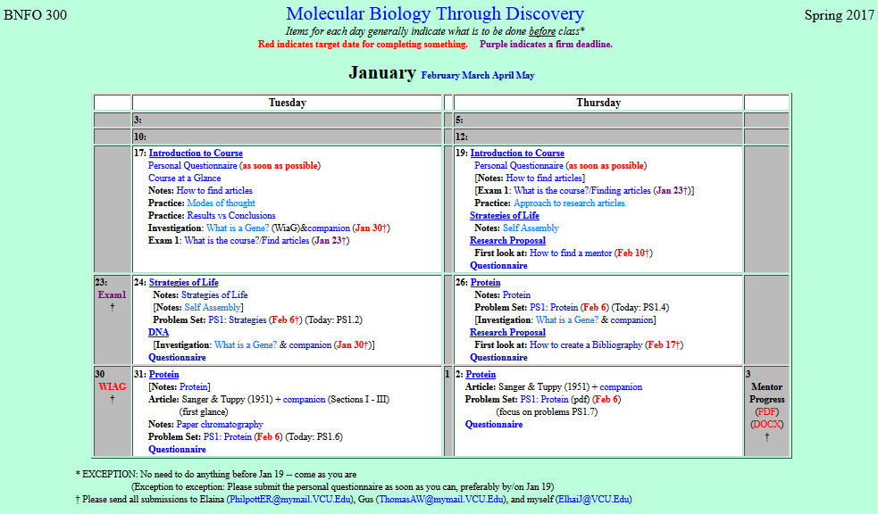
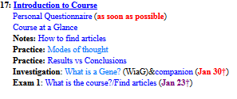
V

Slide 5
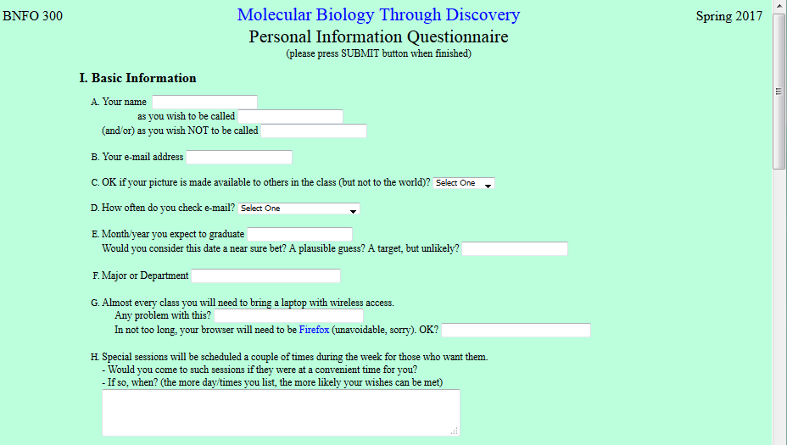

Slide 6
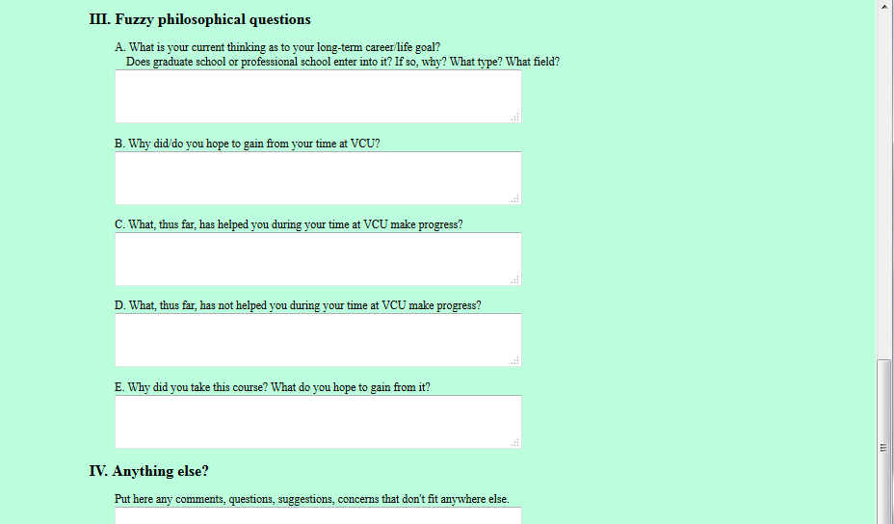
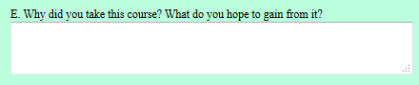

Slide 7
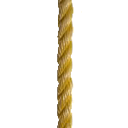


Goals of Course
Firstly, this course is required by my major
to satisfy a mandatory graduation requirement
It's mandatory.
Specific Goals
Why did you take this course? What do you hope to gain from it?

Slide 8
Goals of Course
General Goals
Specific Goals

Slide 9

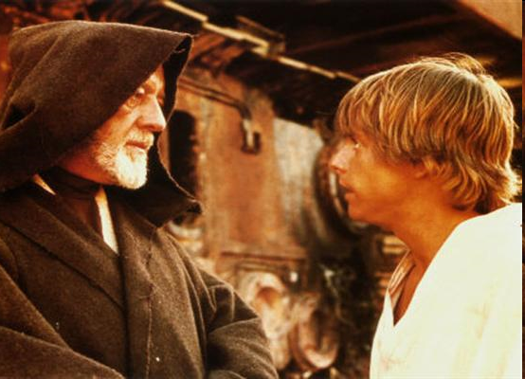
Goals of Course
General Goals
Professional School / Apprenticeship
Liberal Arts Education

Slide 10
Goals of Course
General Goals
Professional School / Apprenticeship
Liberal Arts Education

Slide 11
Rate of Societal Change

Slide 12
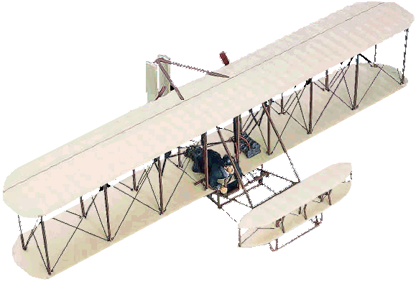
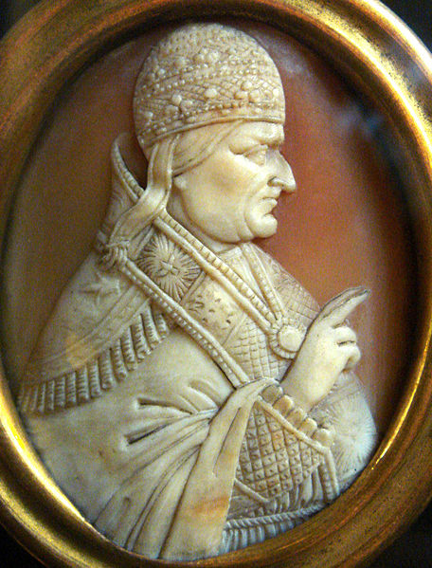
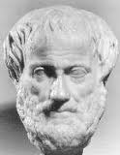


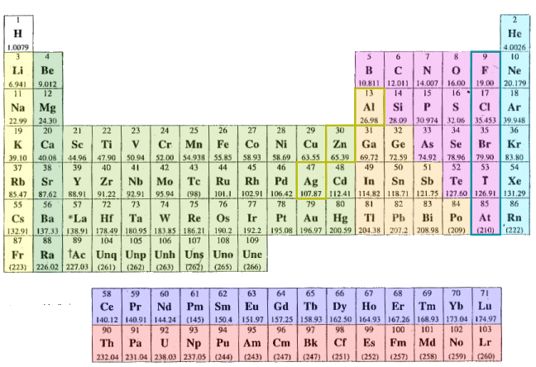

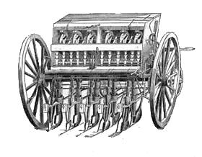
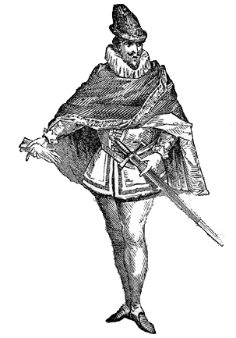

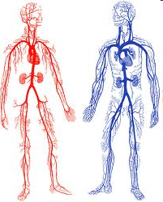

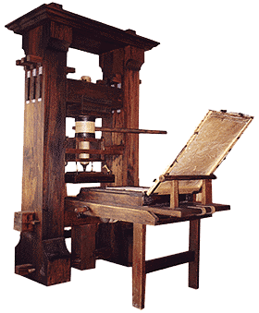
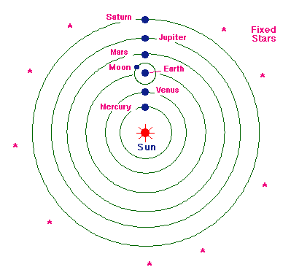
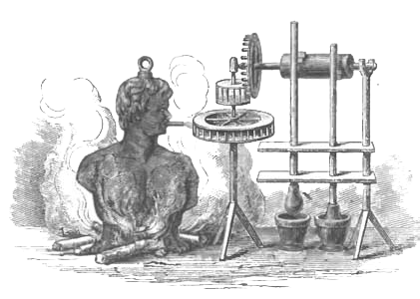
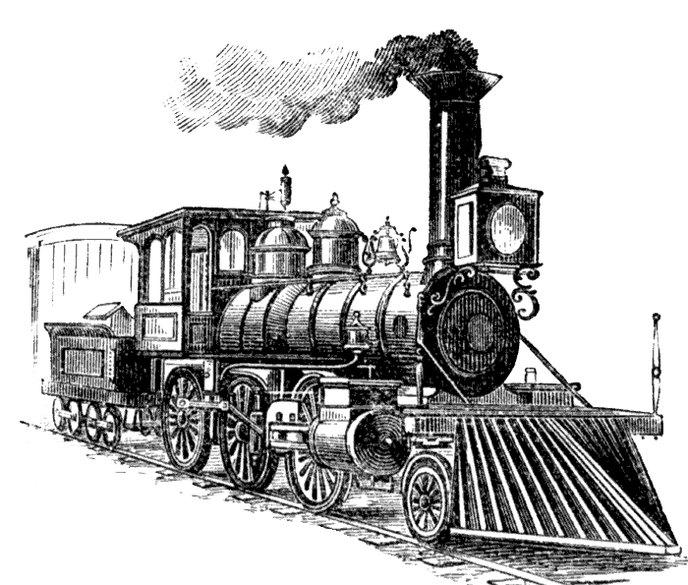
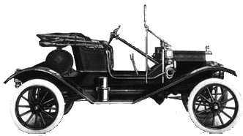
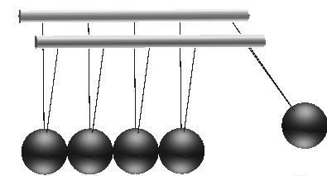


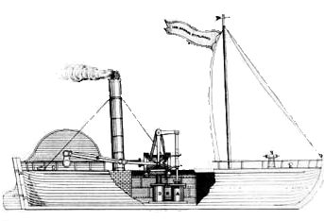
Rate of Societal Change
Airplane
Renaissance
Telephone
Rediscovery of ancient knowledge
Microscopy
Mechanized farming
Plastics
Telescope
Circulatory system
Outdoor gas lighting
Heliocentric system
Printing press
Newtonian mechanics
Locomotive
Automobilie
Atomic energy
Steam engine
Steamship
-600 yr
-500 yr
-400 yr
-300 yr
-200 yr
-100 yr
0 yr

Slide 13
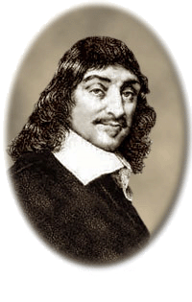

Rate of Societal Change
Airplane
Renaissance
Rediscovery of ancient knowledge
Enlightenment
Telephone
René Descartes
Royal Society
Take nobody's word for it
…it is necessary that at least once in your life you doubt, as far as possible, all things.
Microscopy
Mechanized farming
Plastics
Telescope
Circulatory system
Outdoor gas lighting
Heliocentric system
Printing press
Newtonian mechanics
Locomotive
Automobilie
Atomic energy
Steam engine
Steamship
-600 yr
-500 yr
-400 yr
-300 yr
-200 yr
-100 yr
0 yr

Slide 14
Goals of Course
Liberal Arts Education
General Goals
Independence of learning and thought
Skepticism
Flexibility
Specific Goals
Science is the belief in the ignorance of experts - Richard Feynman
The same (molecular biology)

Slide 15
V

Slide 17
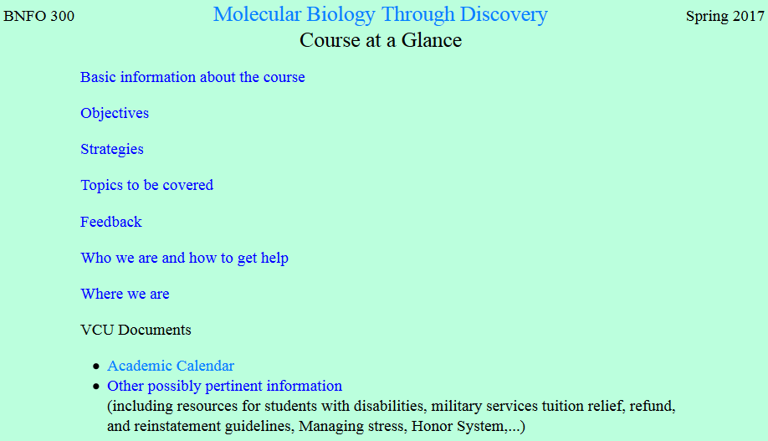

Slide 18
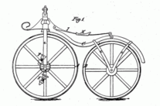
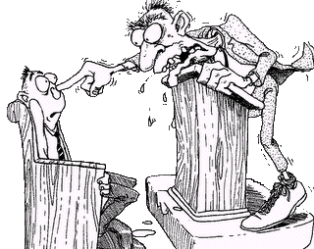
Lecture?

Slide 19
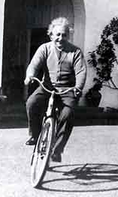
Lecture?

Slide 20
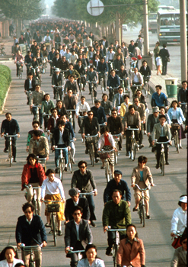


Your role

Slide 21
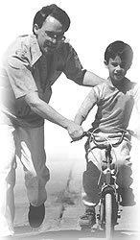

My role

Slide 22
V

Slide 23
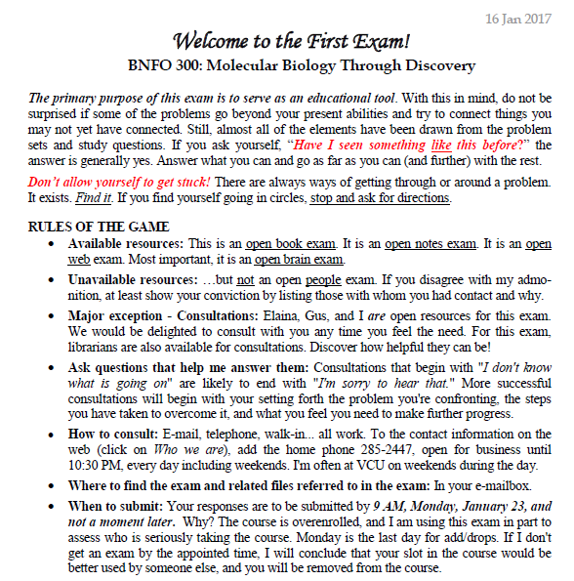

Slide 24
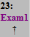
V
No exam…
No course

Slide 25
V

Slide 26
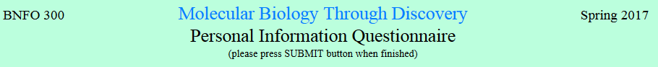
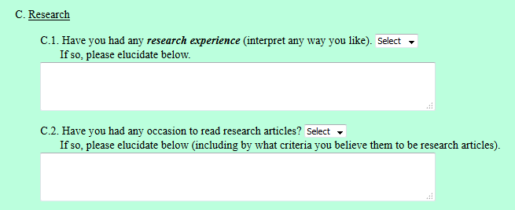
Peer-reviewed.
1. Results (not just assertions)
Repeatable results. Peer reviewed.
2. Methods
peer-reviewed papers found in reputable sources

Slide 27
V

Slide 28

Results vs Conclusions
Me
1N
1S
2N
2S
3N
3S
4N
4S
5N
5S
6N
6S
7S

Slide 29
Results vs Conclusions
Me
1N
1S
2N
1
2
3
4
2S
3N
3S
4N
5
6
7
8
4S
5N
5S
6N
9
10
11
12
6S
7S

Slide 30
Results vs Conclusions

Slide 31
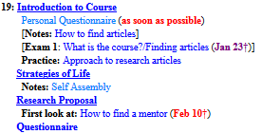

Slide 32
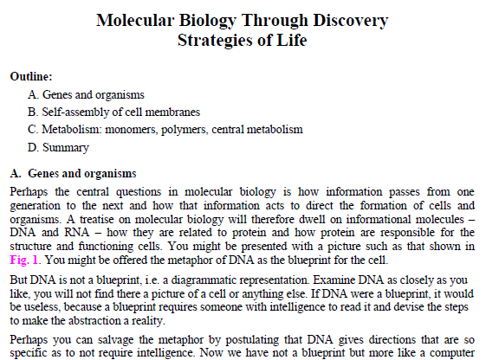
Notes

Slide 33
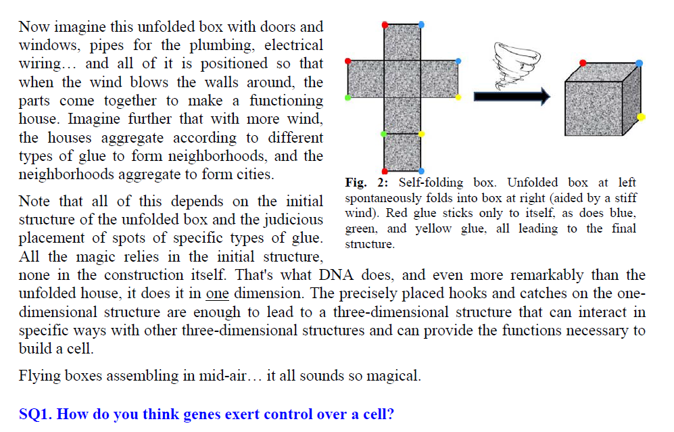
Notes

Slide 35
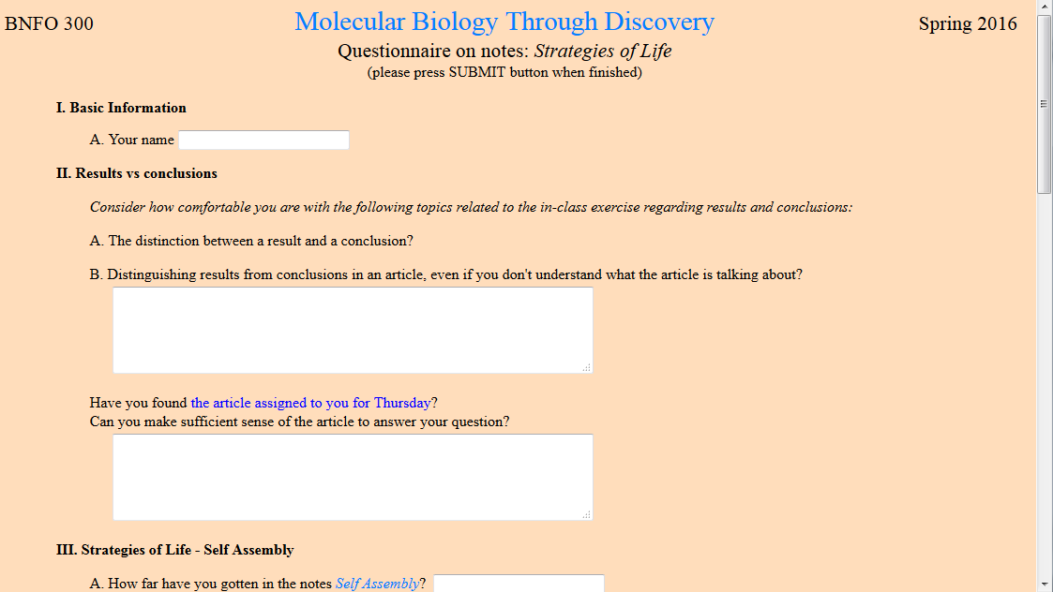


Please by 6 AM the day of class

Slide 38
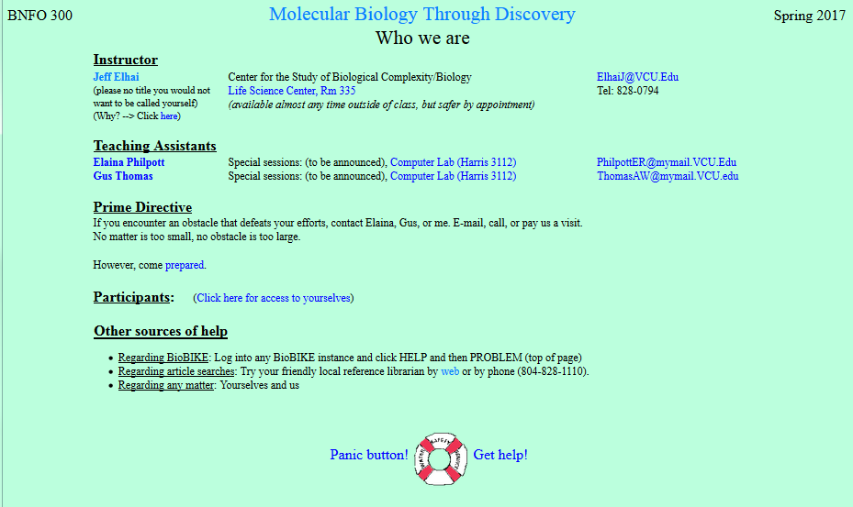
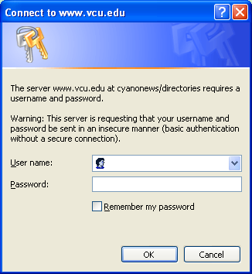
cyano
phyco

Slide 39
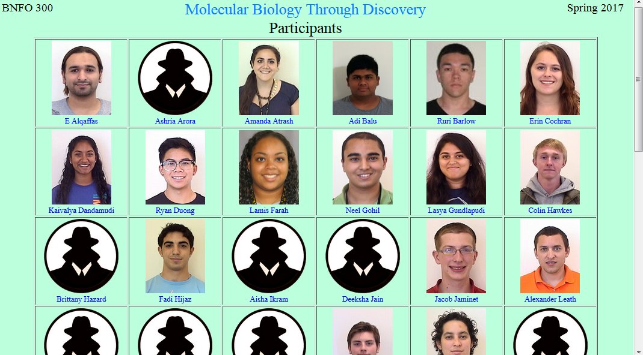

Slide 40
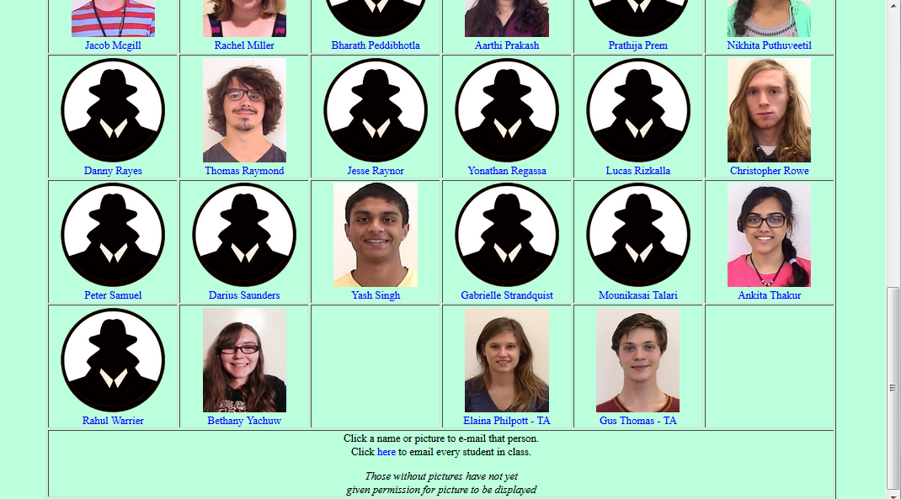

Slide 42
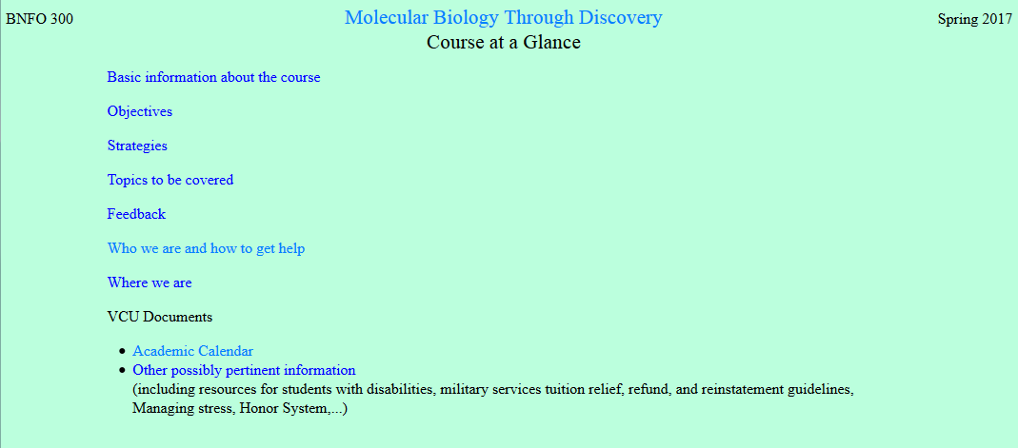

Slide 43
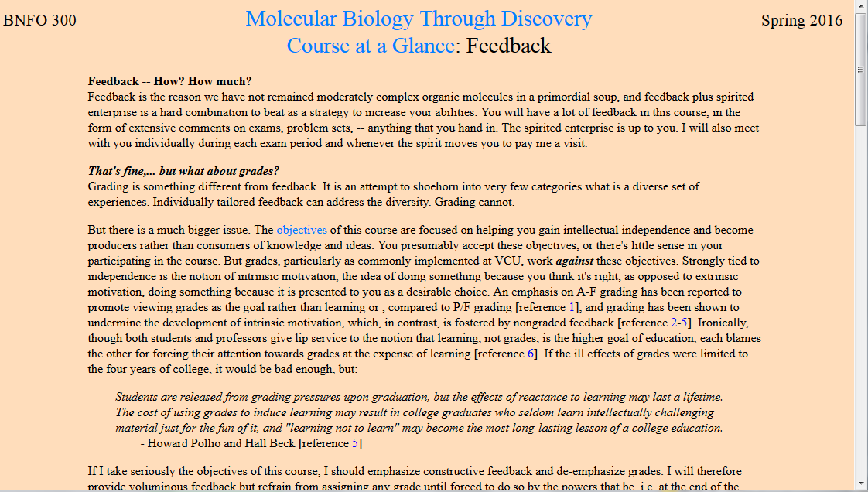
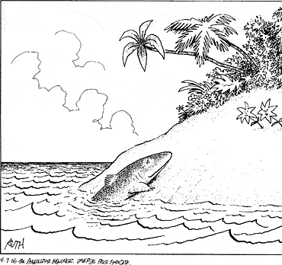
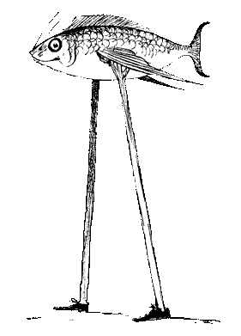
The feedback was the most important part of the class - Respondent, Fall 2013

Slide 44
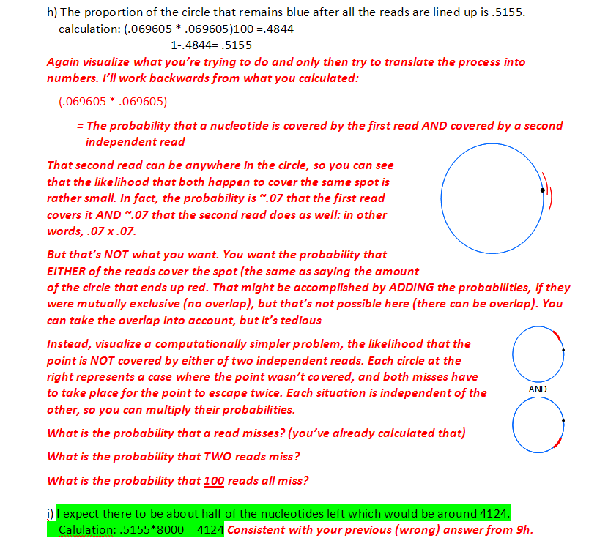
Feedback from an exam

Slide 45


Slide 46

P/F

Slide 47
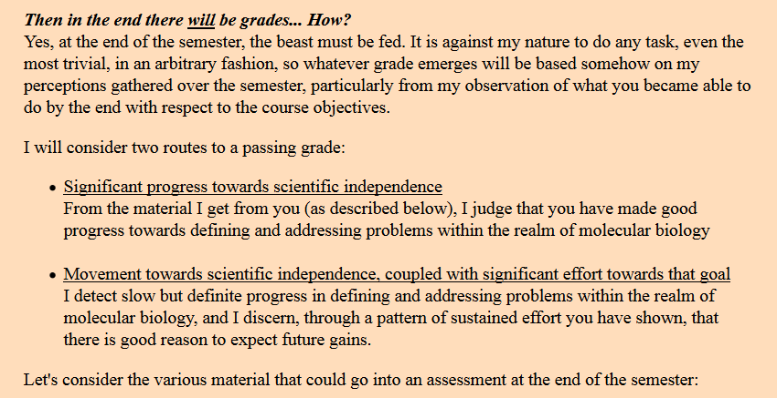

Slide 48
Grades for BNFO 300
2 years ago
1 year ago
W
F
W
F
P
P
Inc
Inc

Slide 49
V

Slide 50
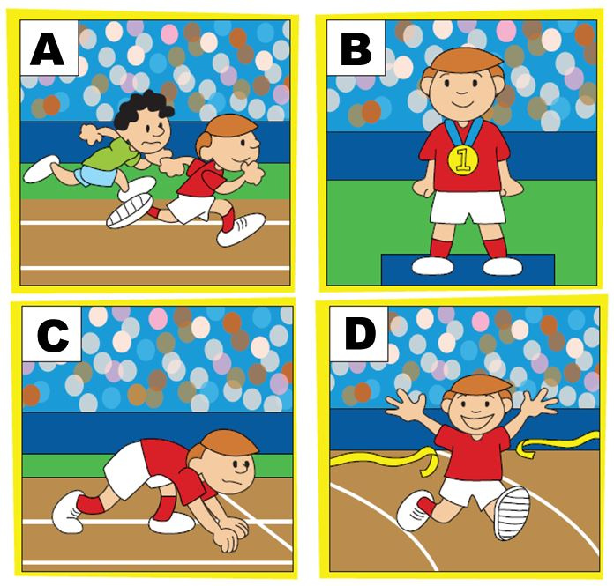
Modes of Thought

Slide 51

Modes of Thought
1. What am I supposed to say?

Slide 52
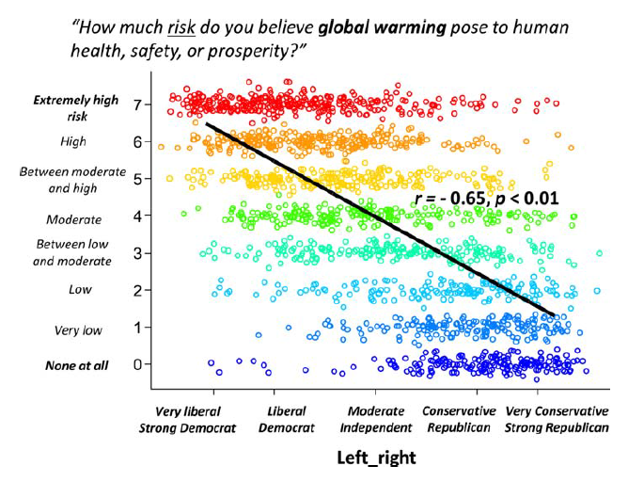
Modes of Thought
1. What am I supposed to say?

Slide 53
Modes of Thought
1. What am I supposed to say?
High risk
Low risk
Liberal
Conservative

Slide 54
V

Slide 55


Slide 56


Slide 57

Modes of Thought
From What If by Randall Munroe

Slide 58
Modes of Thought
1. What am I supposed to say?
2. Yes, you’re right, and…
3. No! what about…?

Slide 60

How to know what to do?

Slide 61






How to know what to do?

Slide 62



Slide 63
Molecular Biology through Discovery Tuesday, 17 January 2017

